Slide 1

EVENTVOID.COM
CAP5100 HCI
Pavan Vishnu Sai Bestha, Sai Saketh Reddy Bonthu, Varshith Reddy Ganji,
Rohan Reddy Jakkam, Dhanush Paruchuri

Slide 2
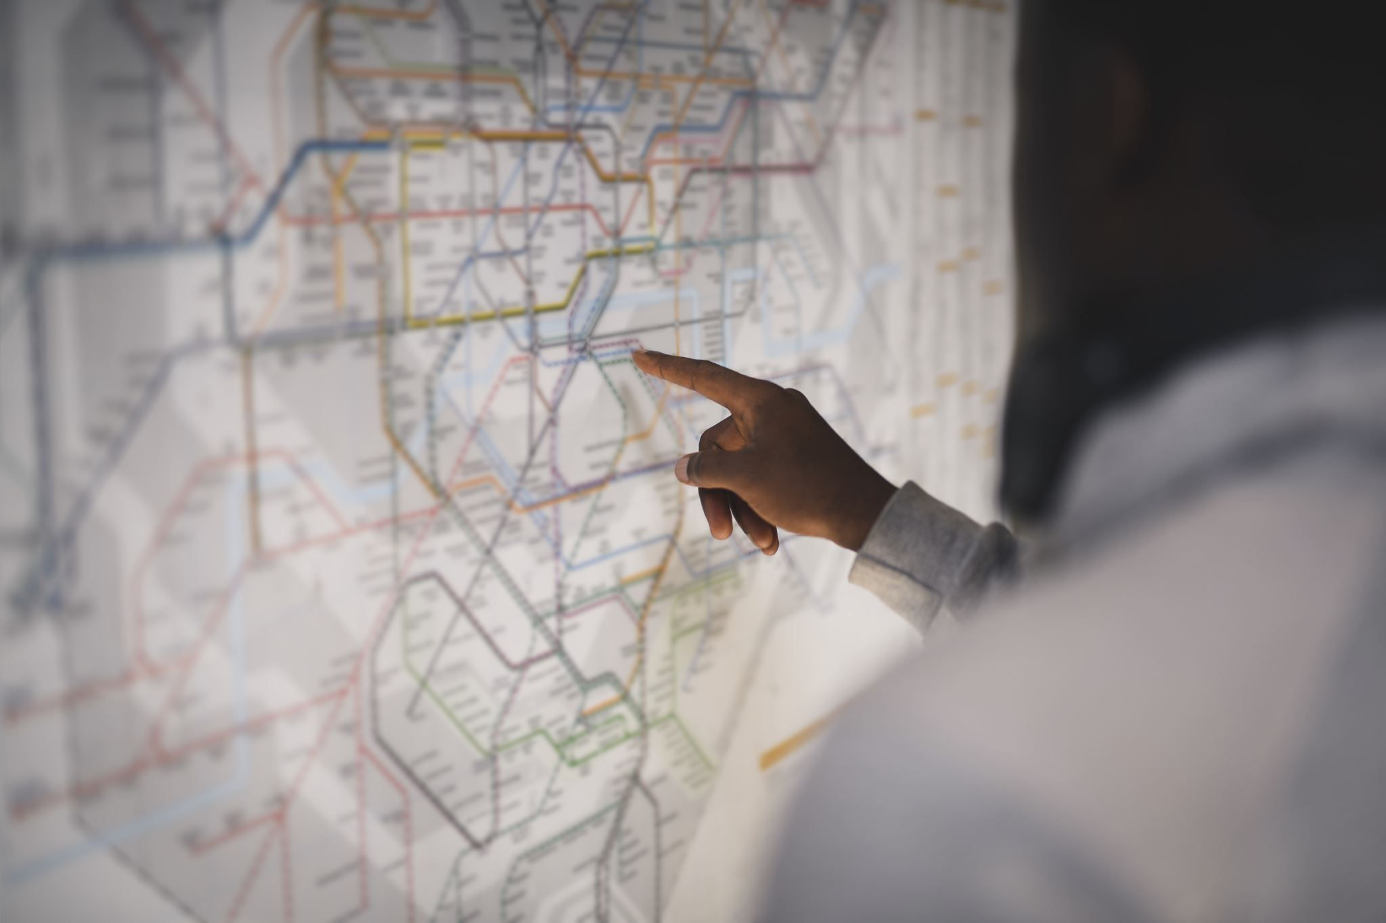
User-Centered Design Process
Problem and Context Exploration: Designing a solution to help students of the “University of Florida” promote and find student events.
User needs Identification : Transportation, Location(Visualized map), List of Amenities, Event Description, Security measures detailed.
Requirements Gathering: Initial Brainstorming with the team, then running a focus a group to better understand the requirements needed.

Slide 3
Starting point
We were presented with a problem to create a website which would help college students find events. So, we initially sat down as a team and started brainstorming the basic needs of a website which would serve this purpose.
Brainstorming: It is a creative problem solving technique that involves generating a large number of ideas in a short amount of time.
Through this process, we set a project focus to conduct user research activities.
We framed demographic, warm-up, and open-ended discussion questions to use in the user-research of user-centered design process.
We tried to identify the design probes required.

Slide 4
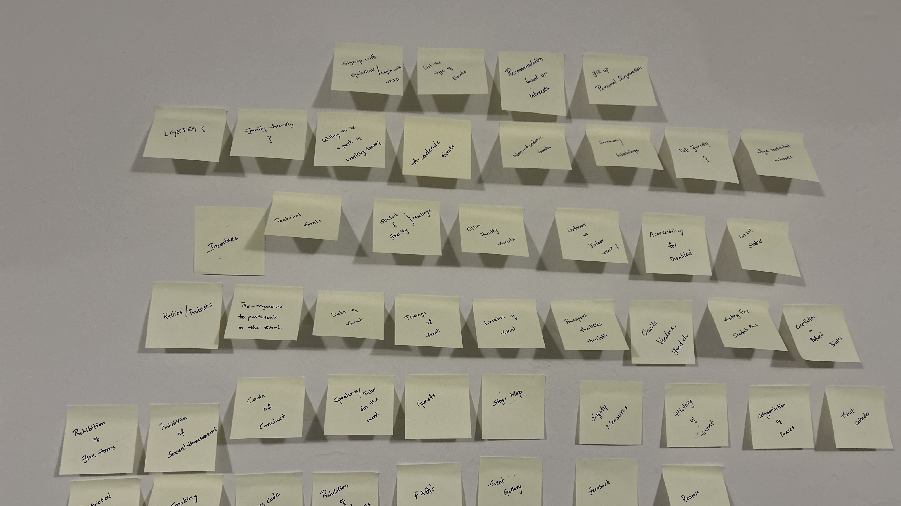
Initial Brainstorming (Unorganized)

Slide 5
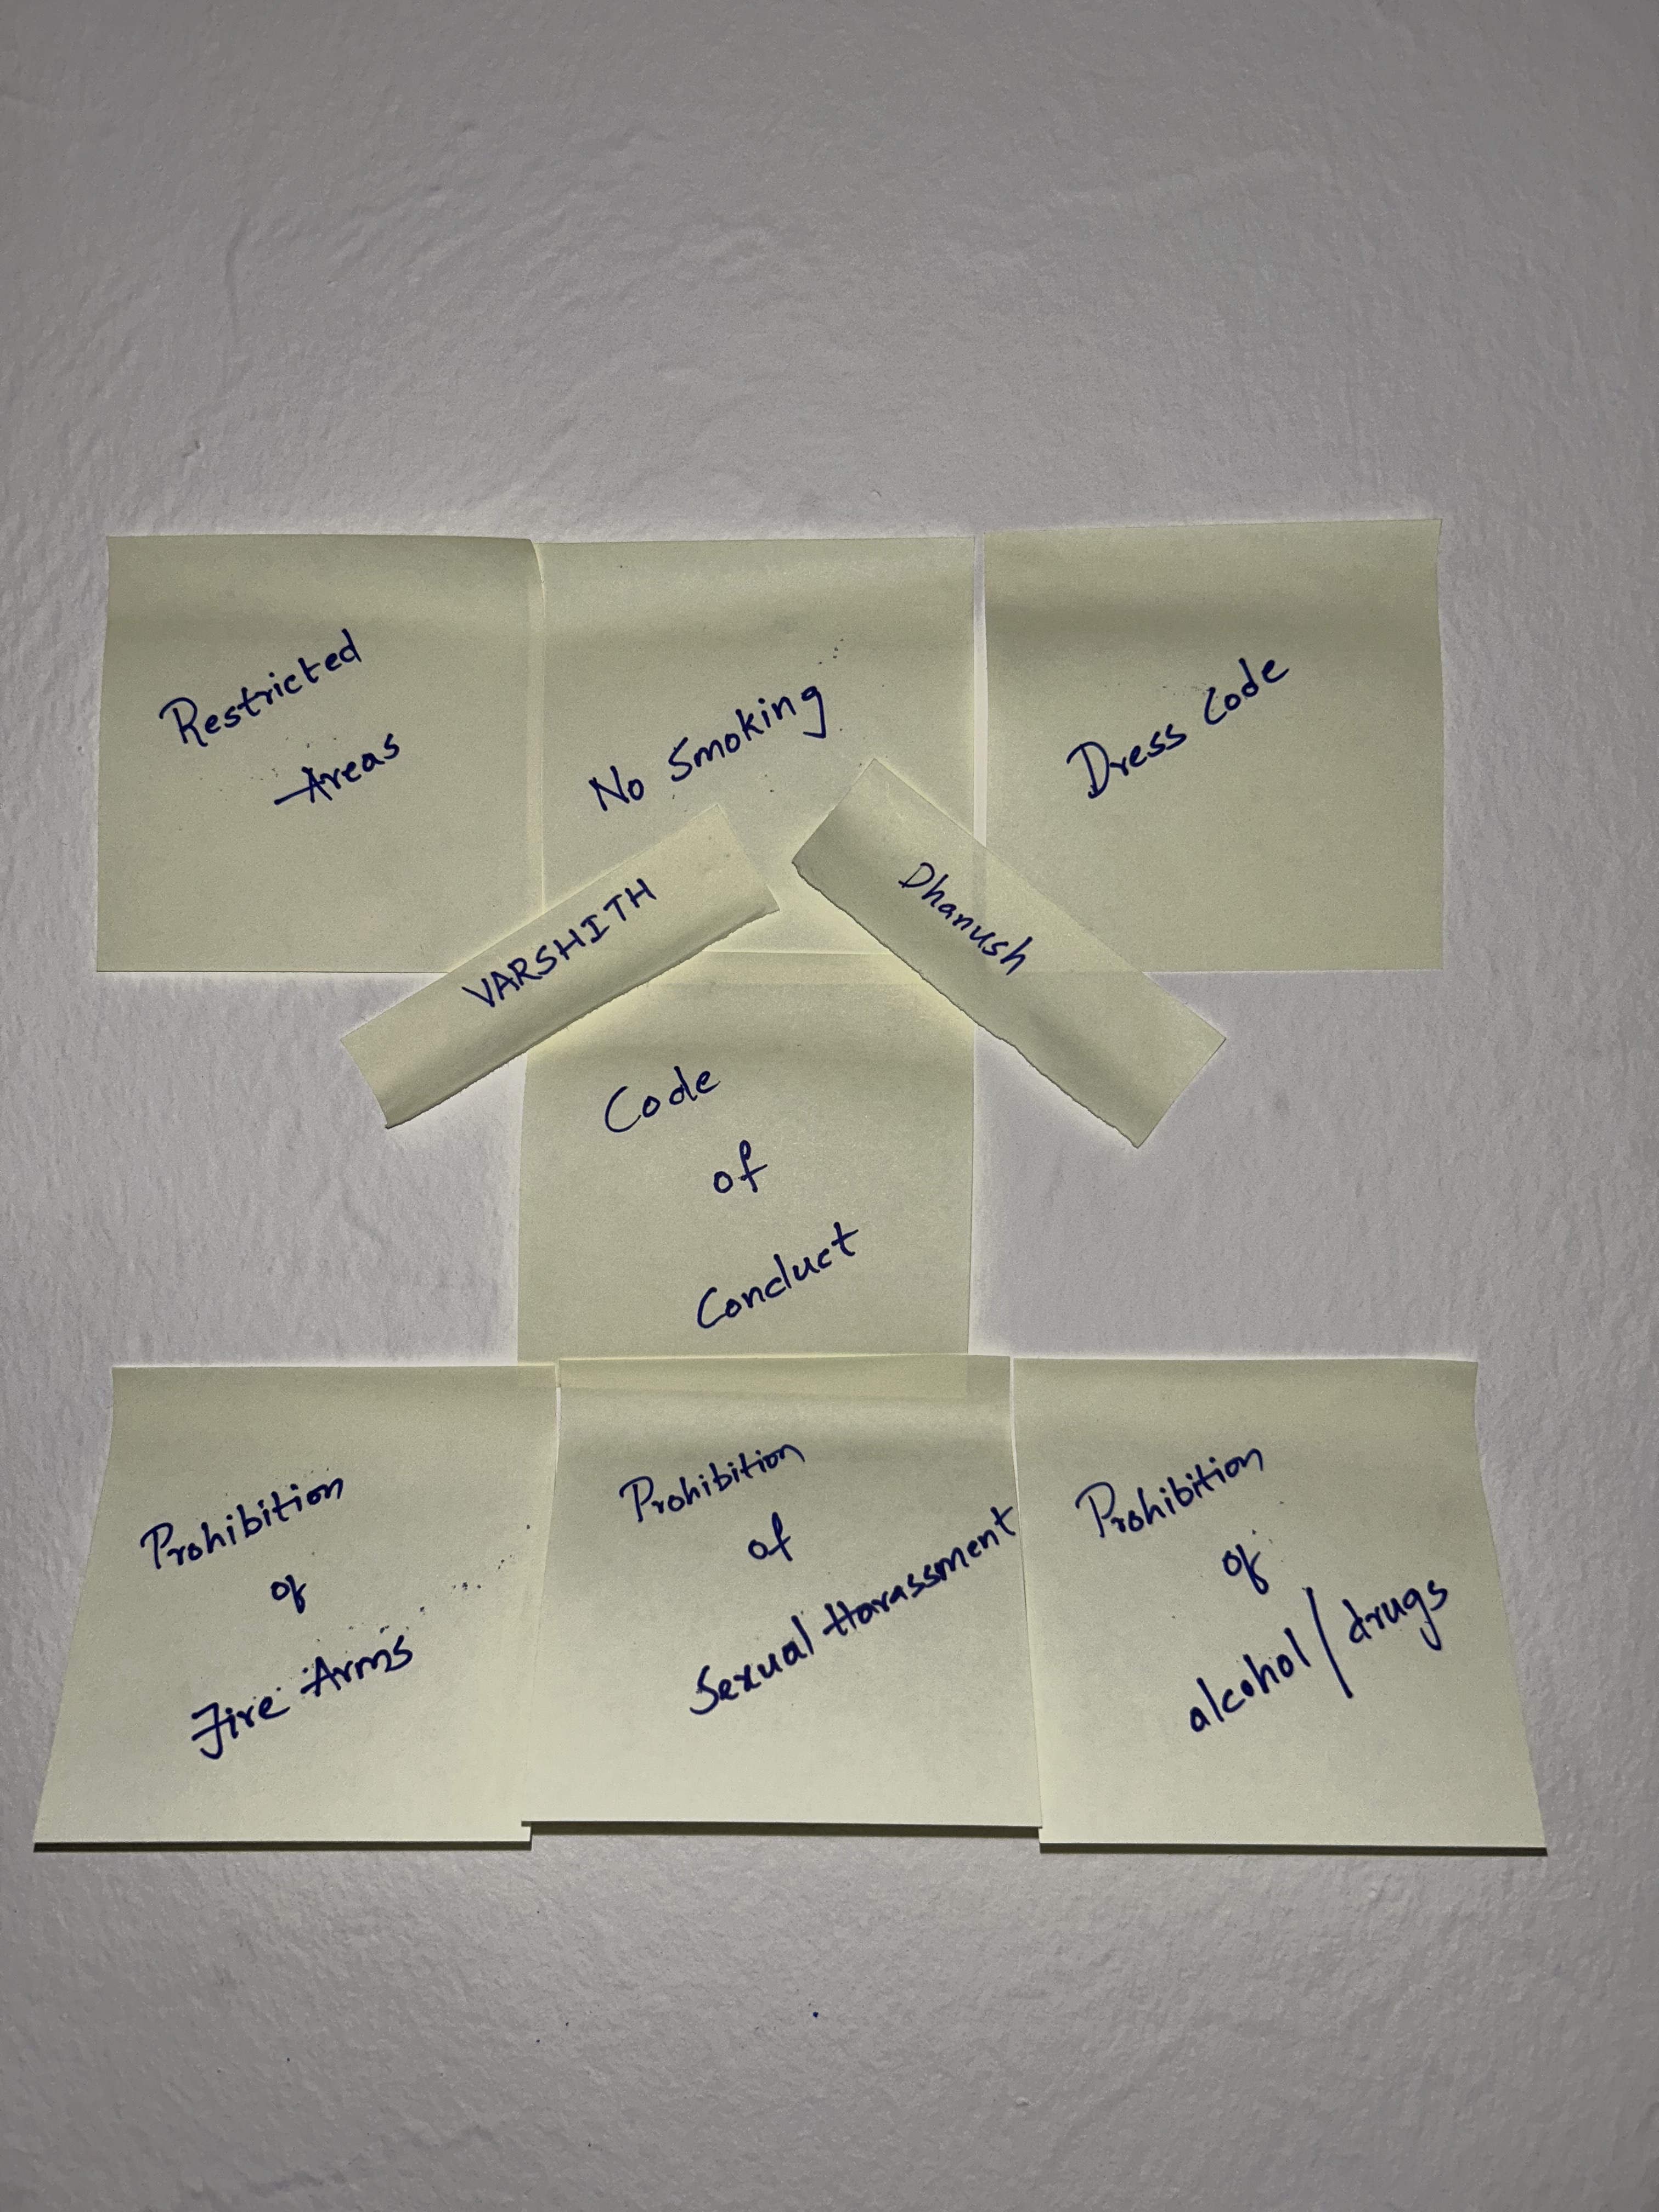
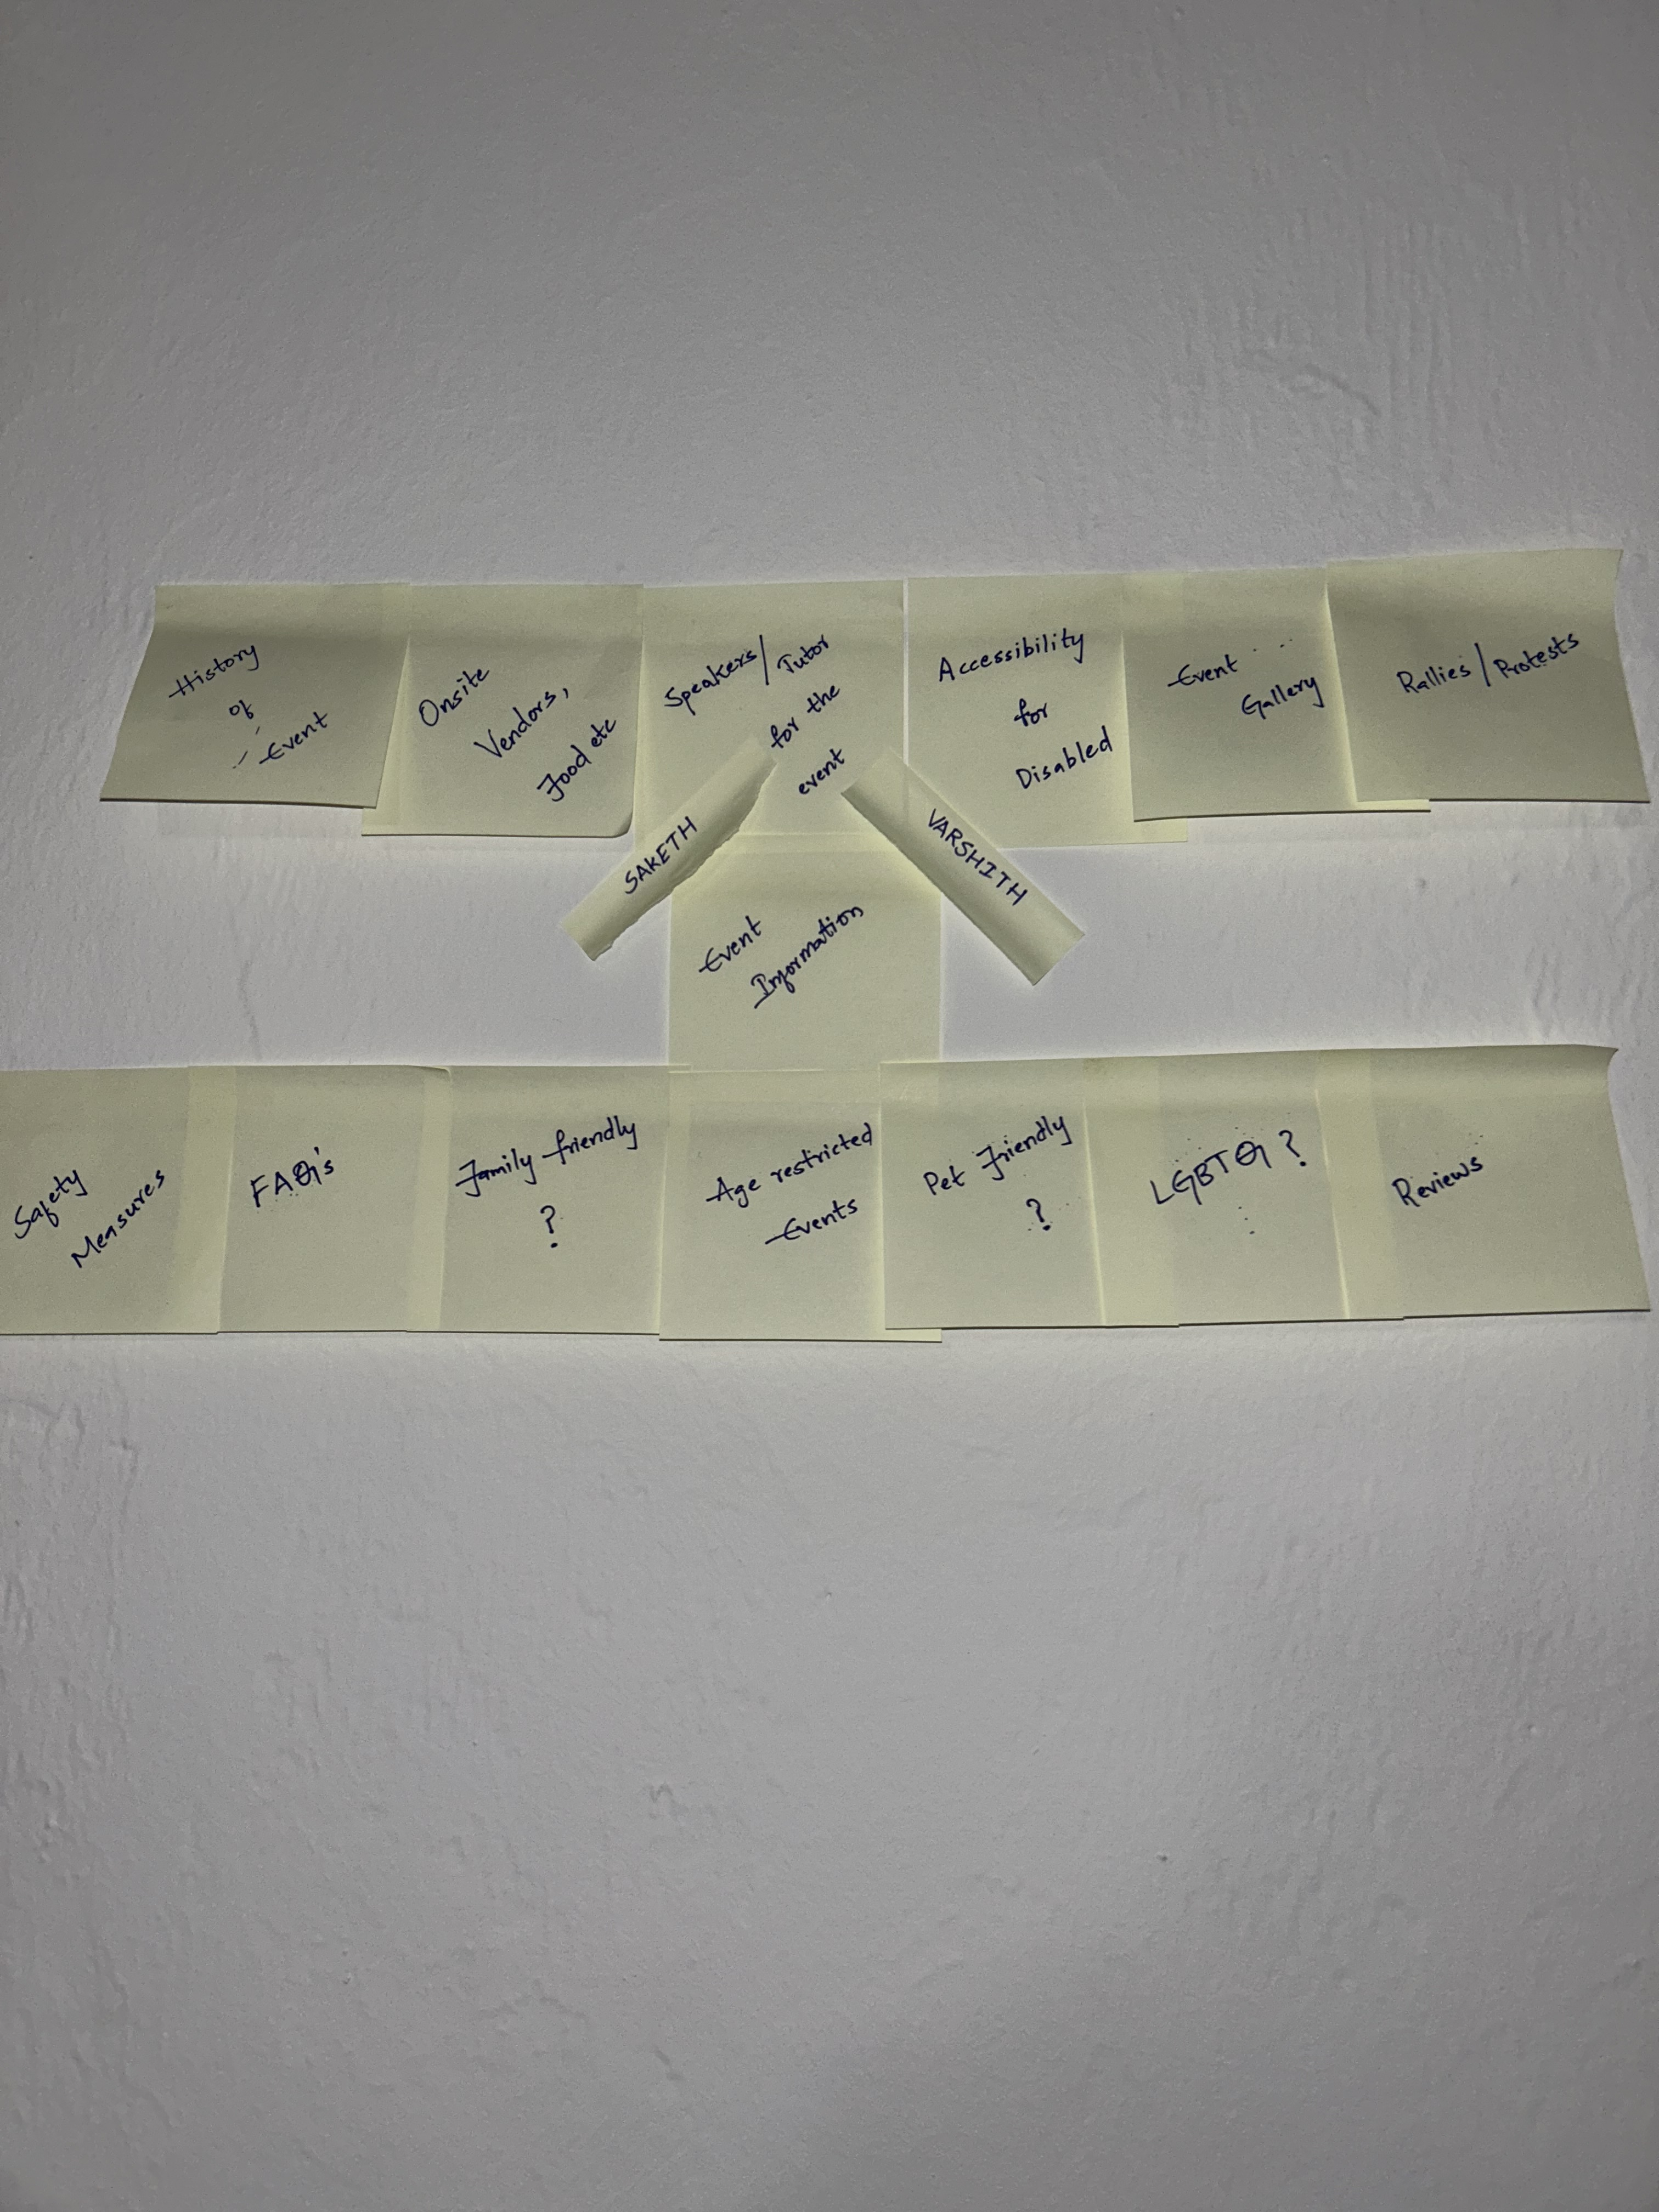
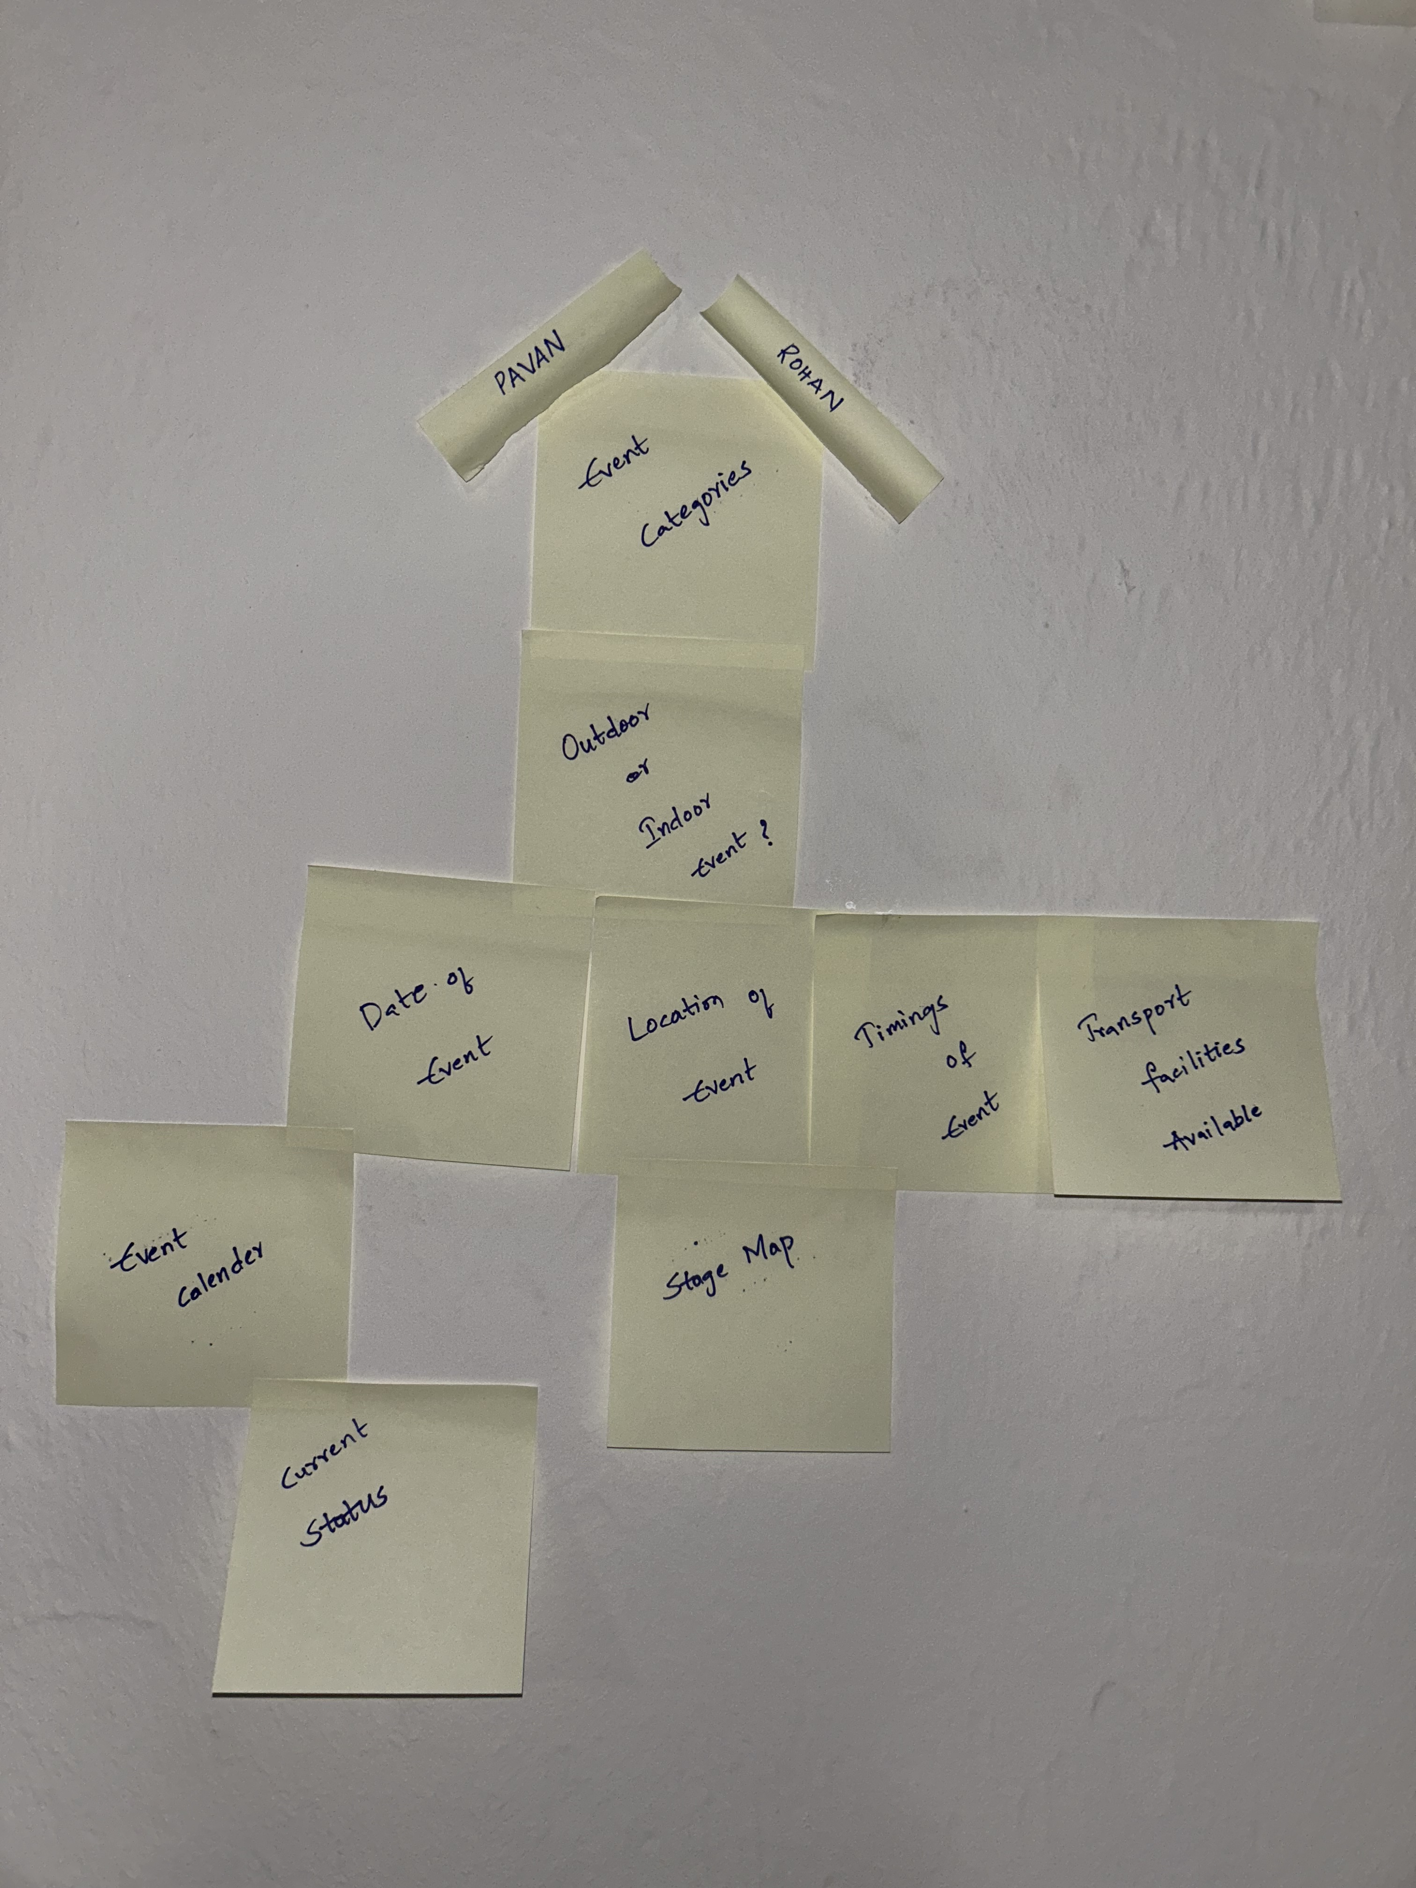
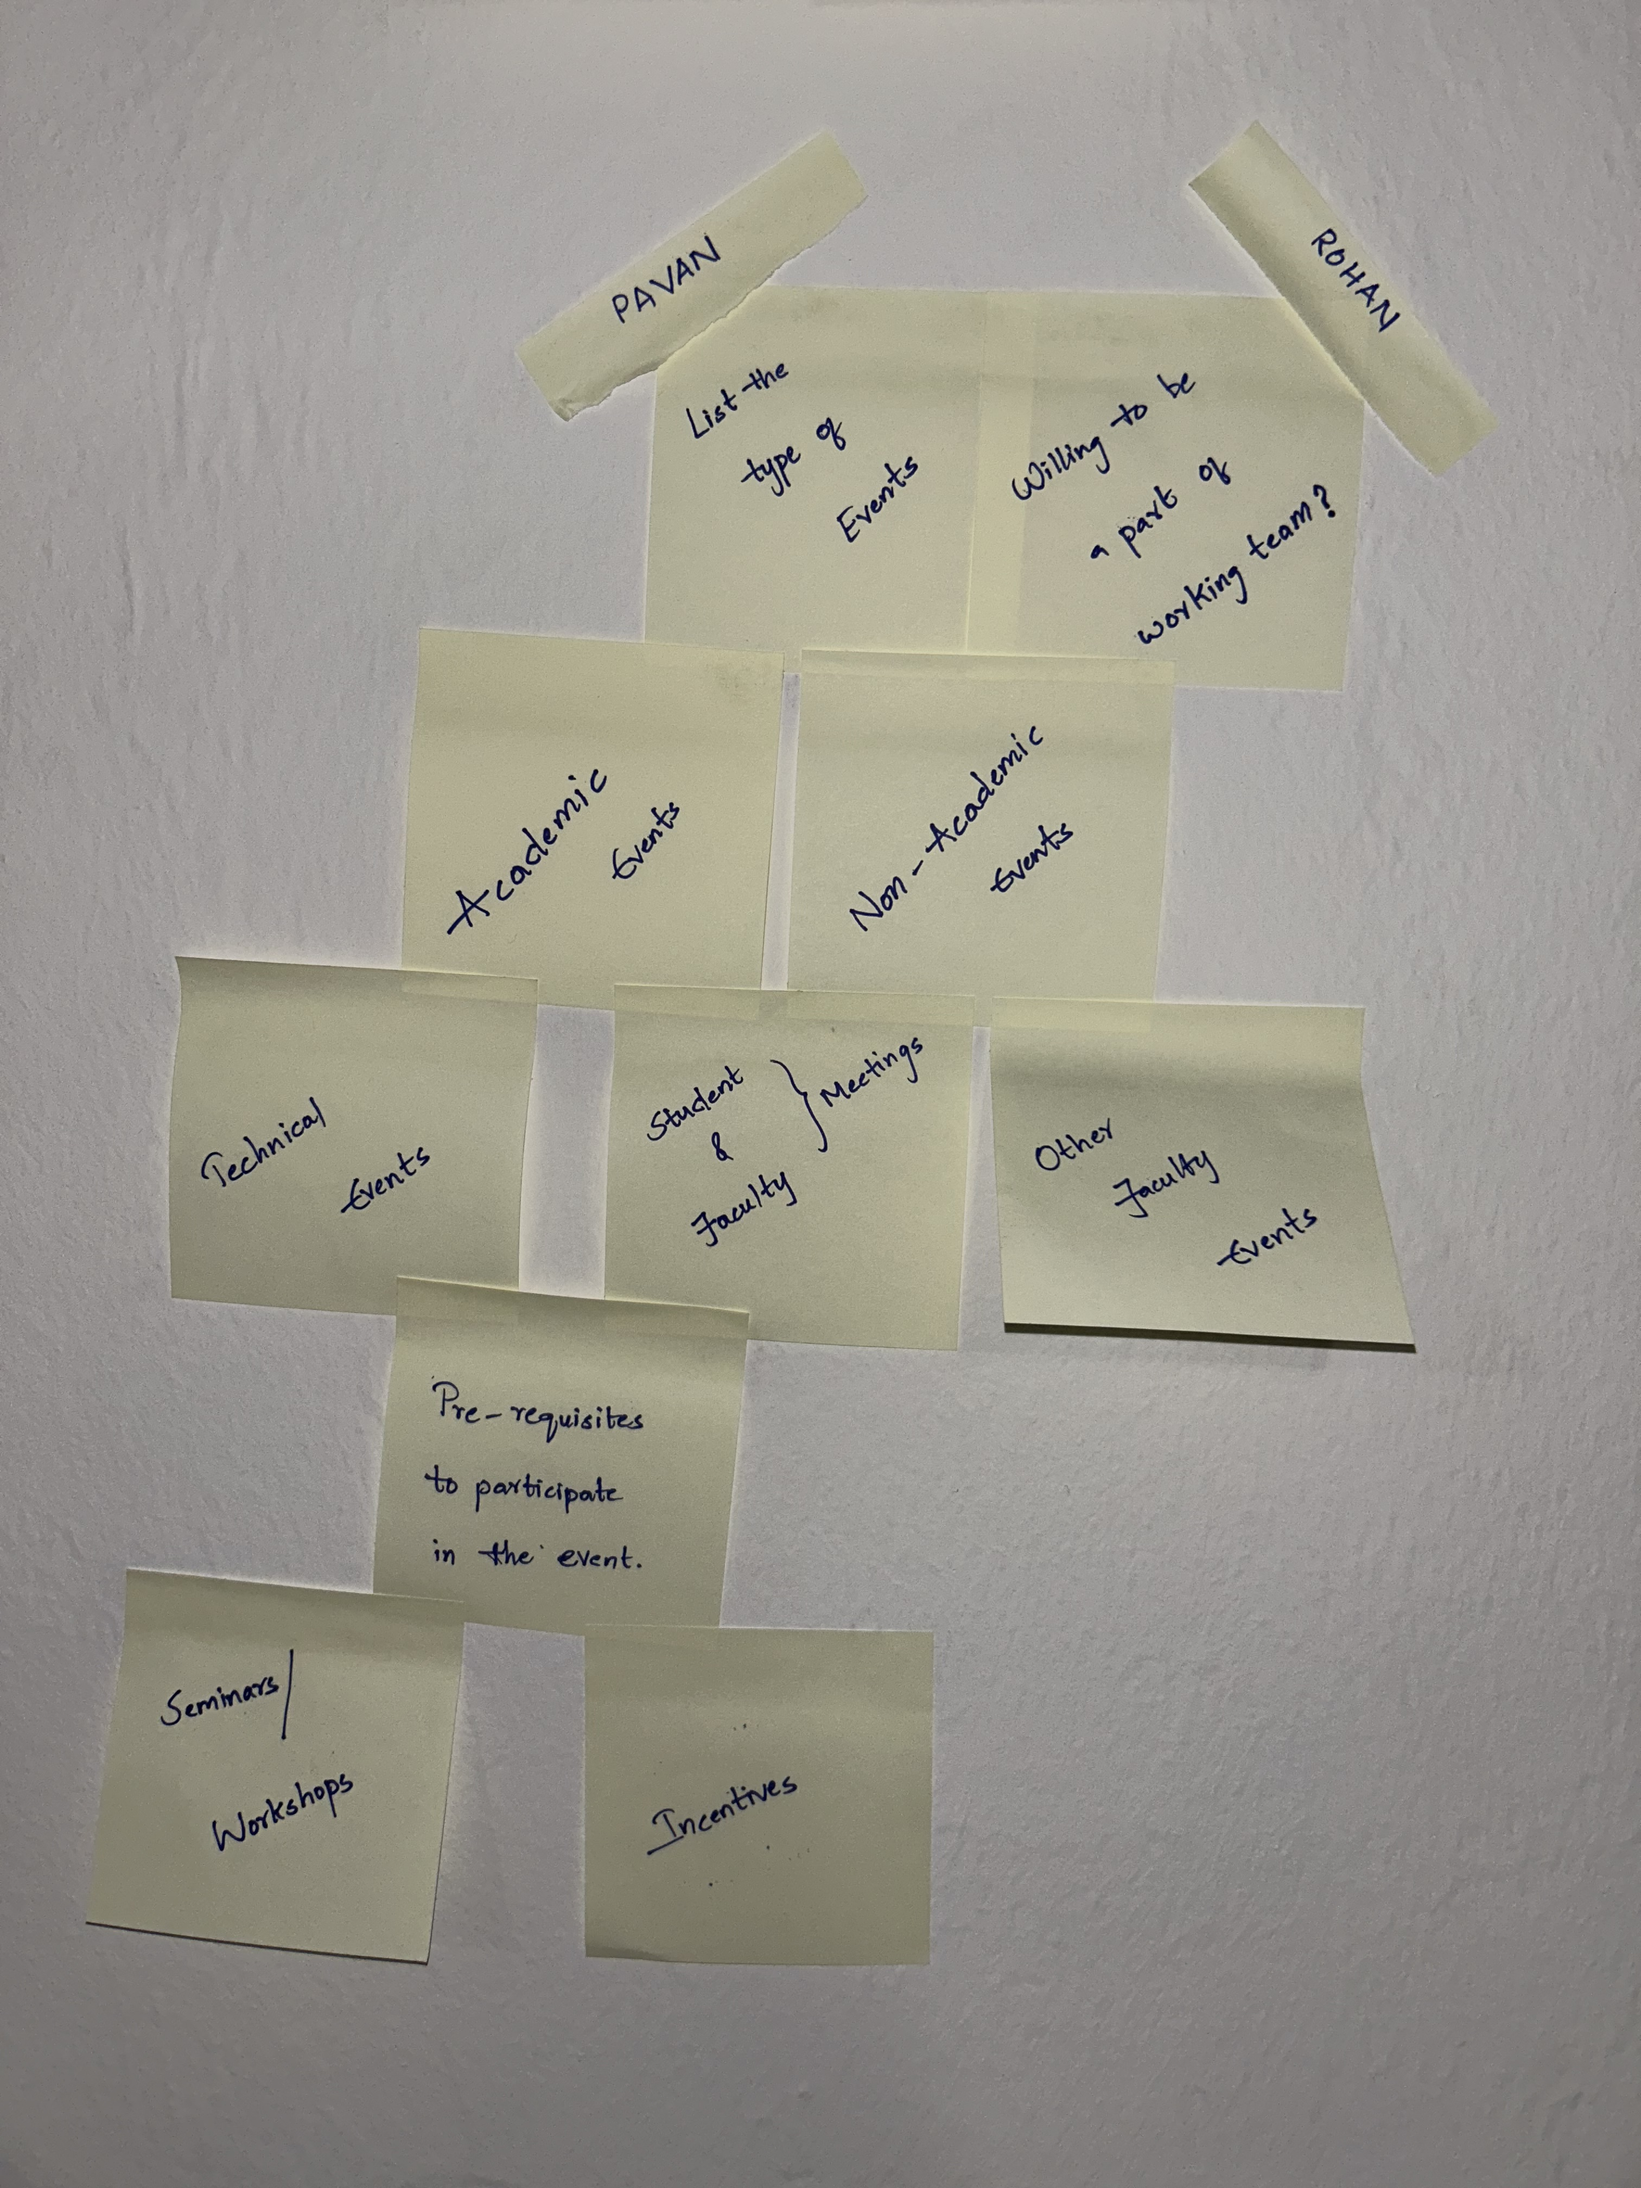
Initial Brainstorming(Organized)

Slide 6
Running a Focus group
Focus group: It is a qualitative research method used to gather opinions and feedback from a group of individuals on a specific topic.
We created a focus group consisting of 4 people to gather in-depth insights required for this purpose.
We framed a set of open-ended questions to guide the discussion and ensure that all relevant issues are covered.
We captured all the comments of the focus group and prepared a digital affinity diagram.

Slide 7
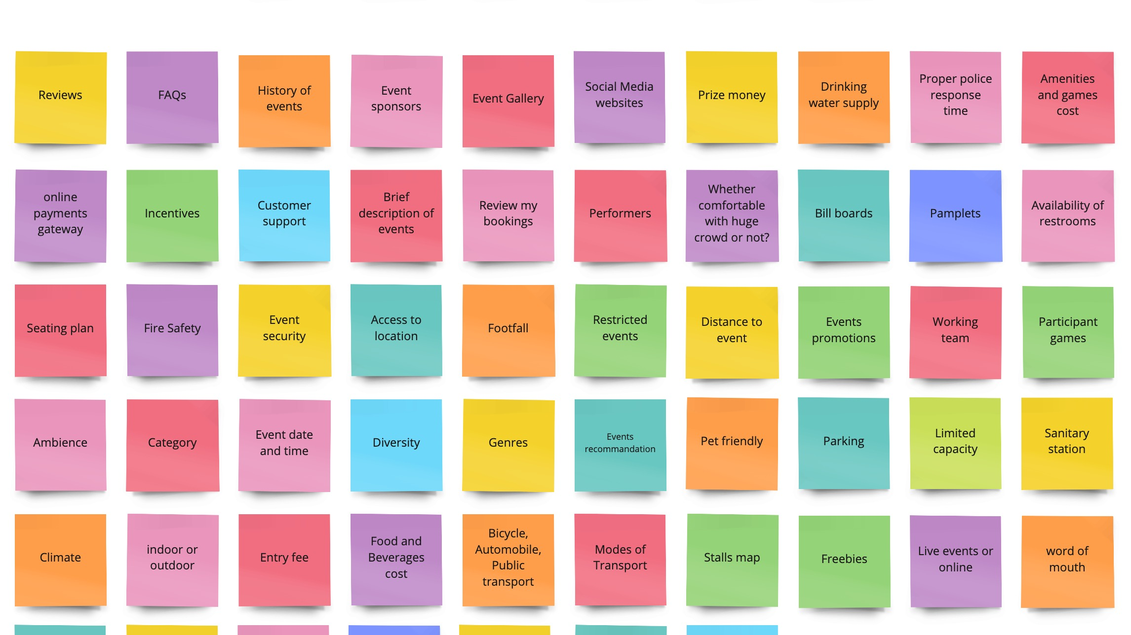
Digital Affinity Diagram after running focus group (unorganized)

Slide 8
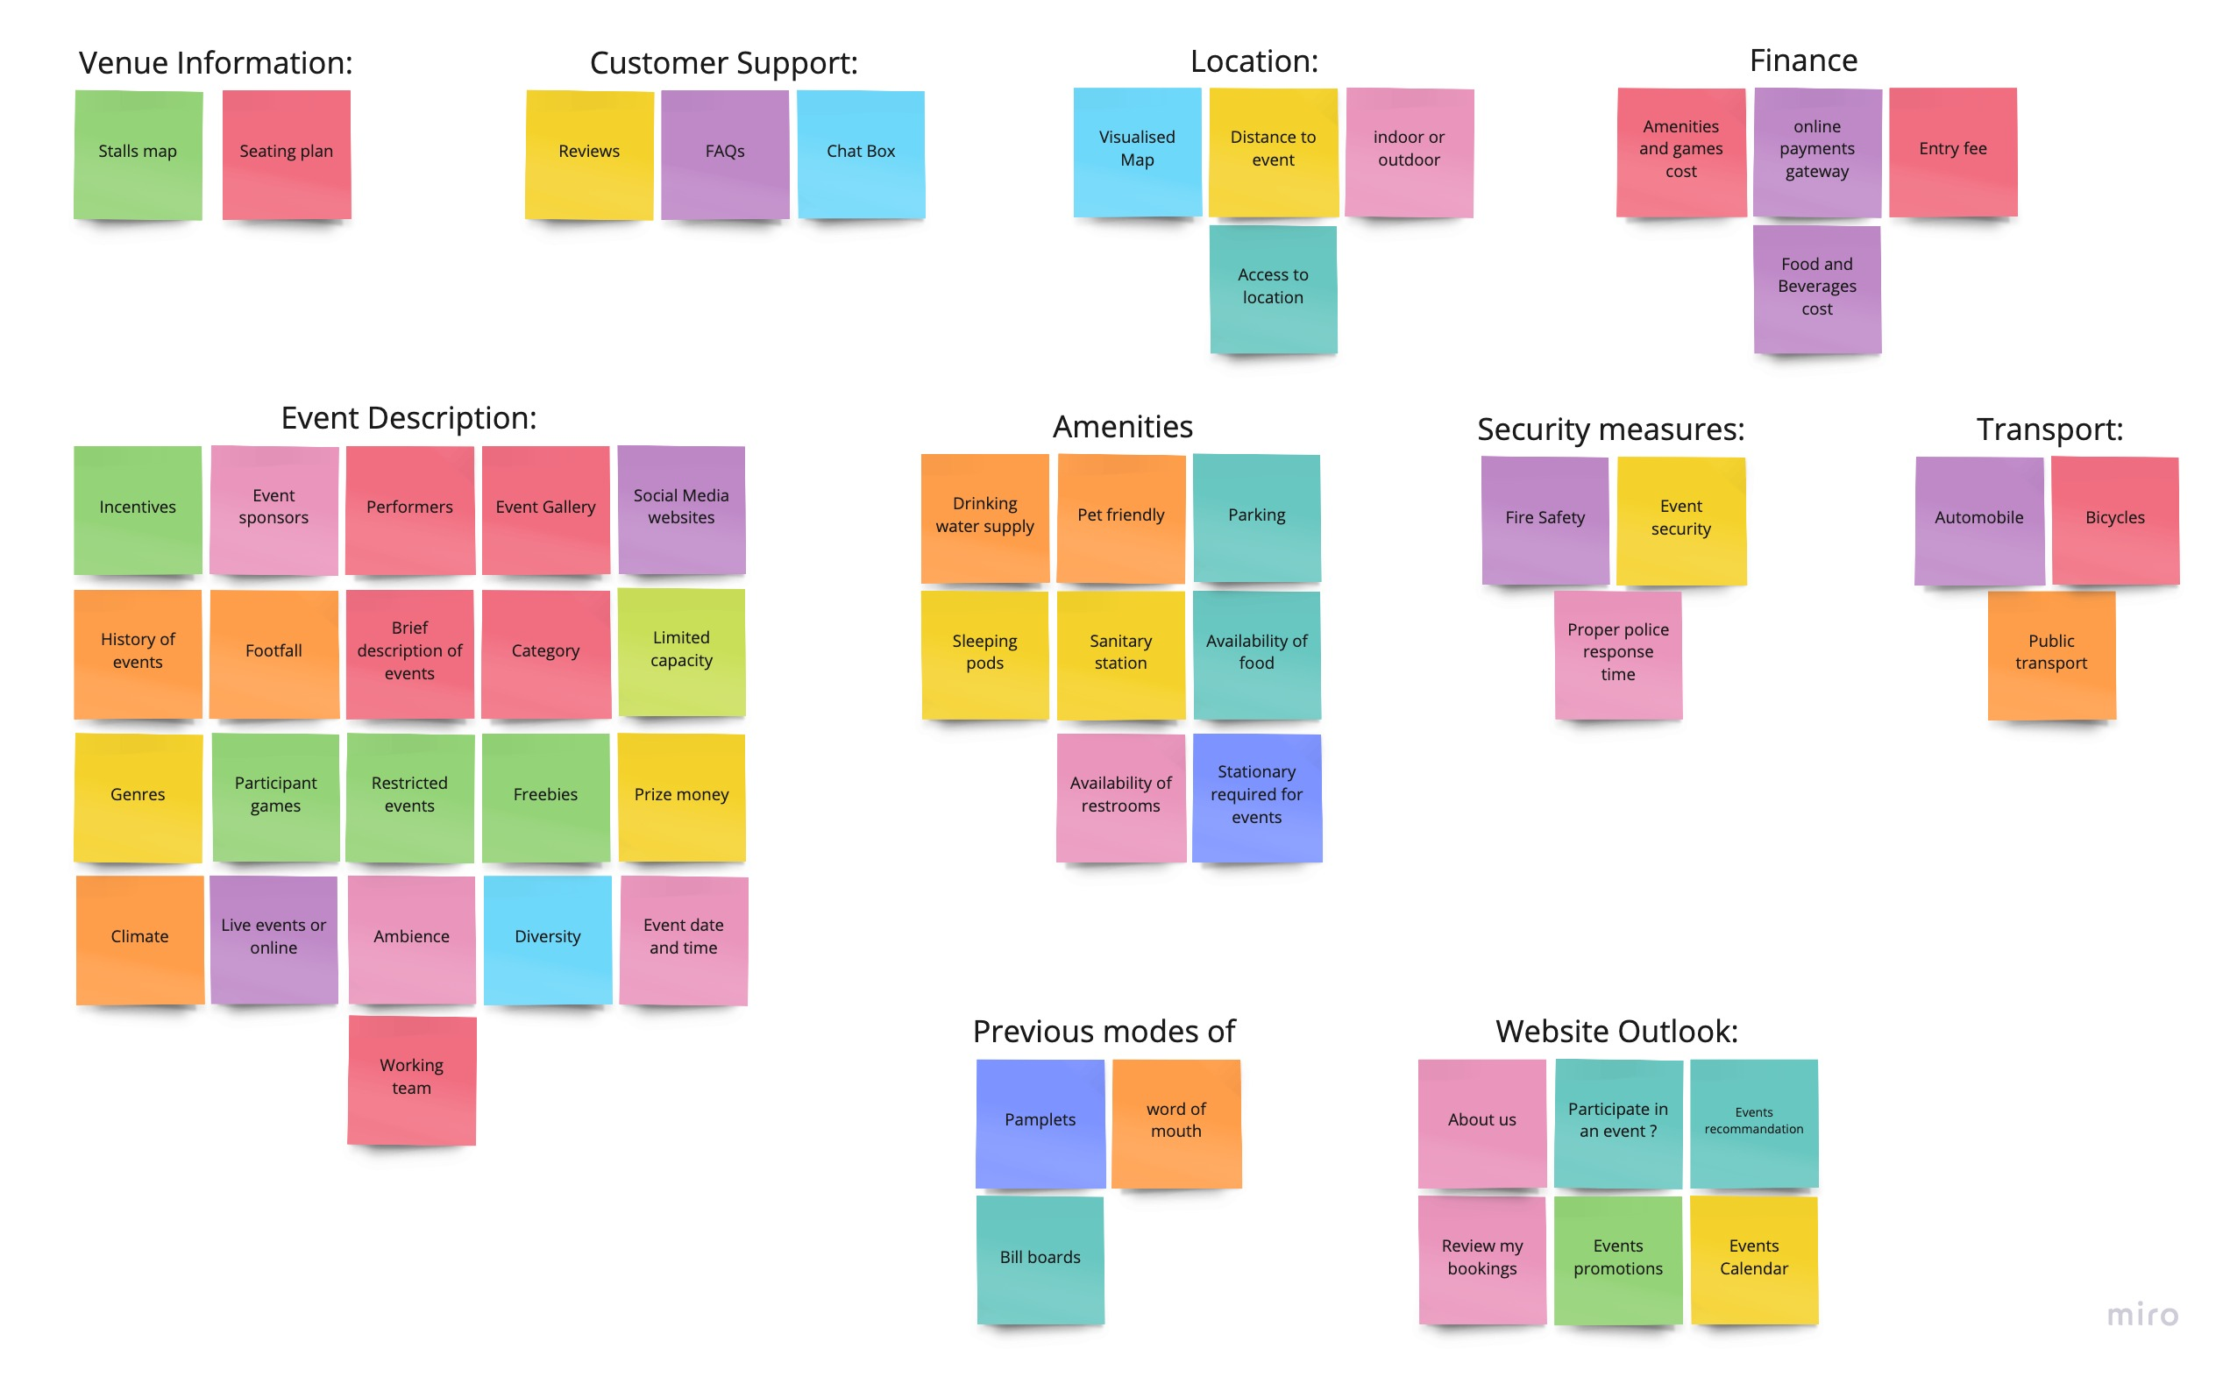
Digital Affinity Diagram after running focus group (organized)

Slide 9
Design features we contemplated
Interactive User Interface:- The UI is fun to use and responsive. Events and their descriptions are displayed clearly.
Up-to-date information:- Latest events are updated on time, and all event timings and Venues are mentioned clearly.
Visualization:- From your location to the event, a map of the venue including the location of stalls, restrooms are displayed on the website.
Event Calendar:- An Interactive Event Calendar is shown on the website which is a brief timeline of the events which are going to occur.

Slide 10

Personas
A persona is fictional representation of a specific user group based on the research data gathered.
After the initial process of brainstorming and creating affinity diagrams, we created personas to better understand the users we are designing the product for.
We created two personas of two extremes to cover all the bases of user needs required.

Slide 11
Scenario’s and Storyboard’s
A scenario is a narrative that describes a specific situation in which a user might interact with a product or service..
We created scenarios based on the personas to know how user groups might interact with the website to accomplish a task.
The scenario was visually depicted using storyboards.
We created two storyboards for the two scenarios we thought of.

Slide 12
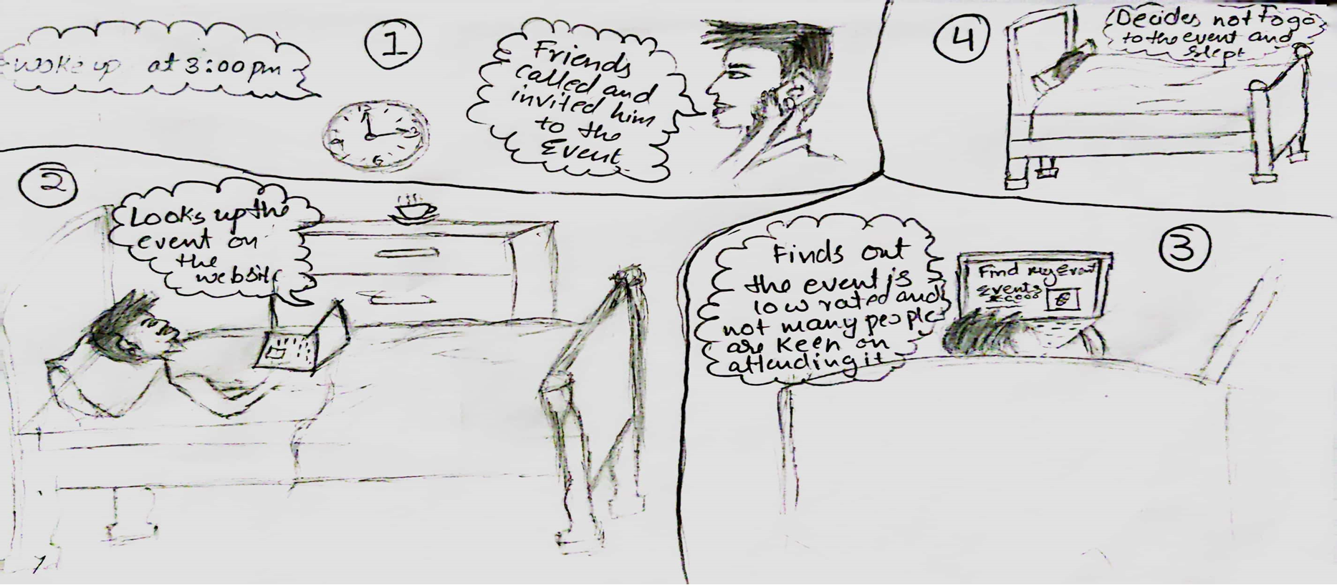
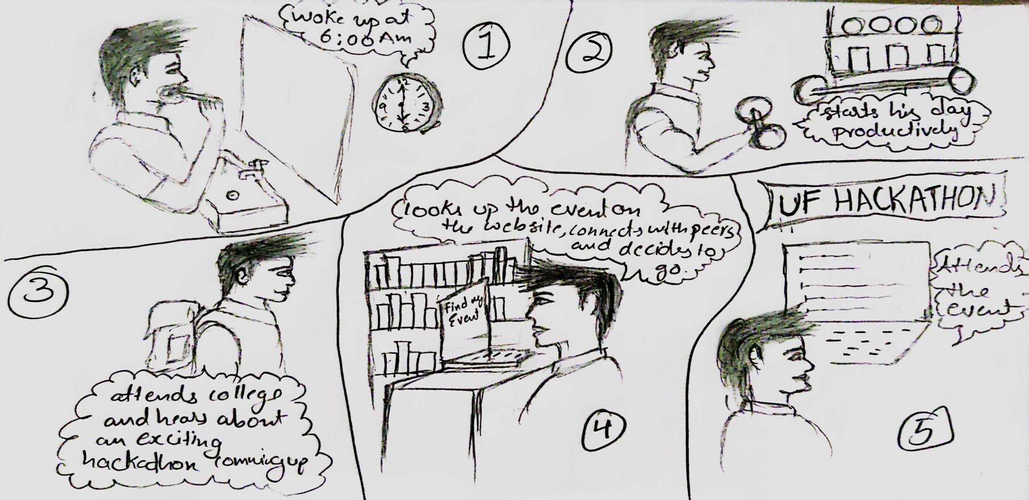
Storyboard's
Storyboard 1
Storyboard 2

Slide 13
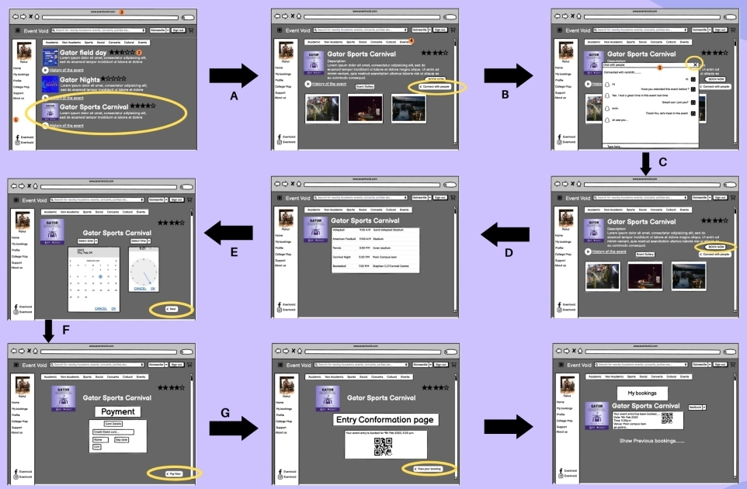
Initial Mid point Prototype
Wireframing Diagram
Initial Website submitted
https://sites.google.com/view/www-eventvoid-com/home

Slide 14
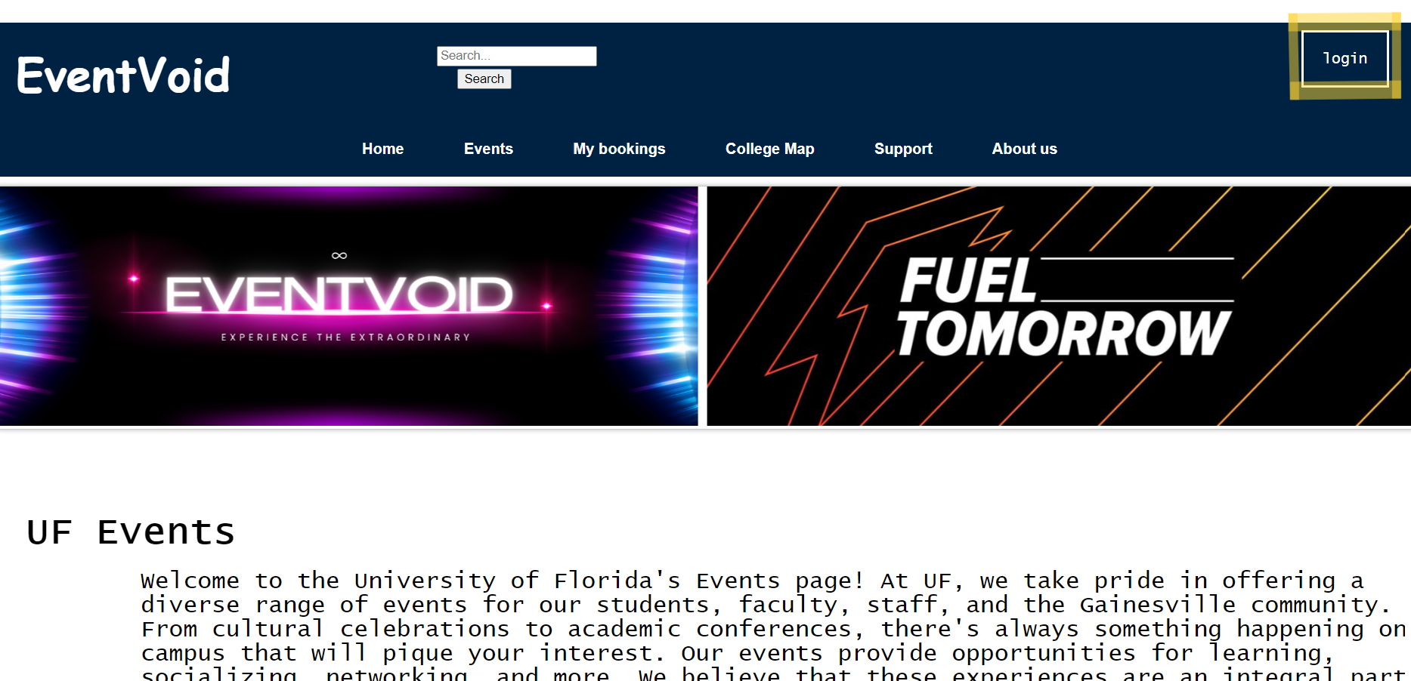
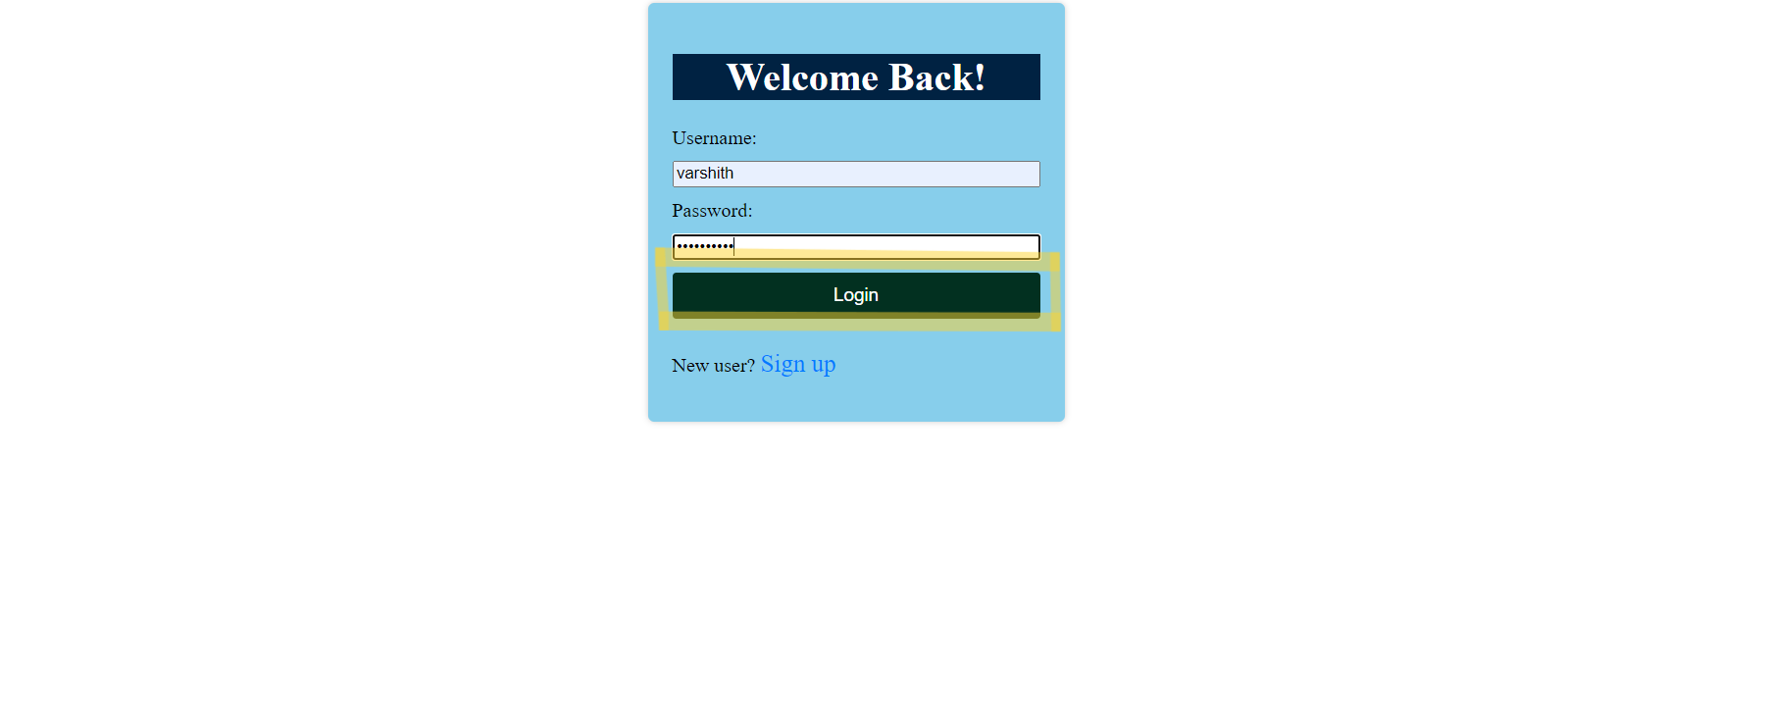
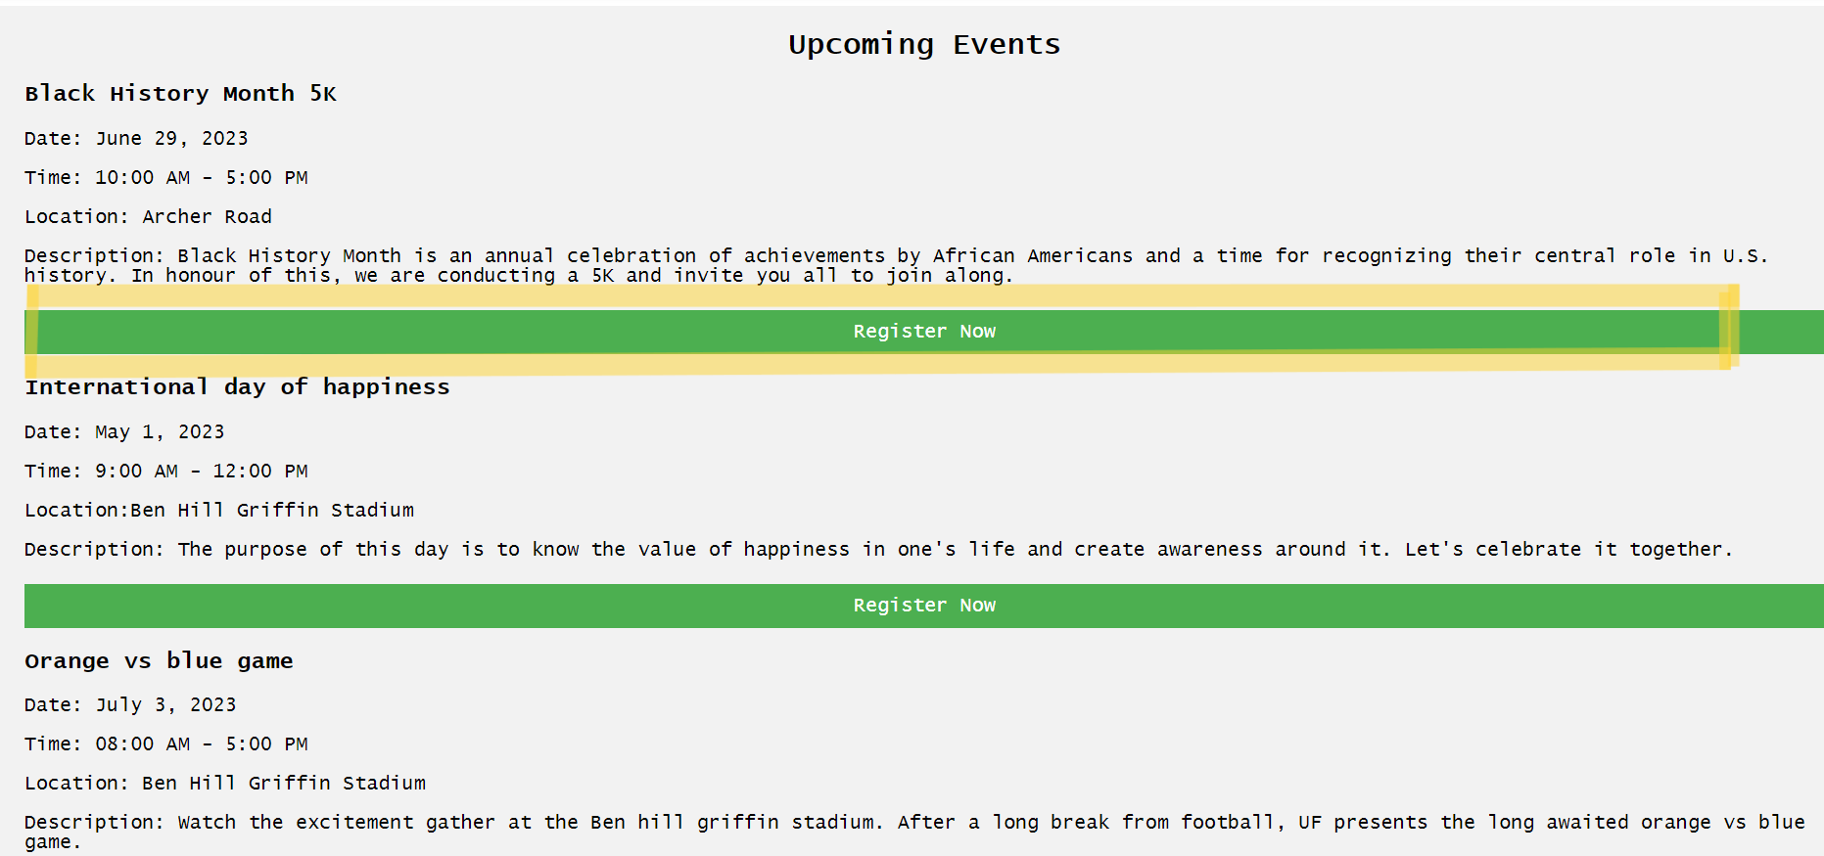
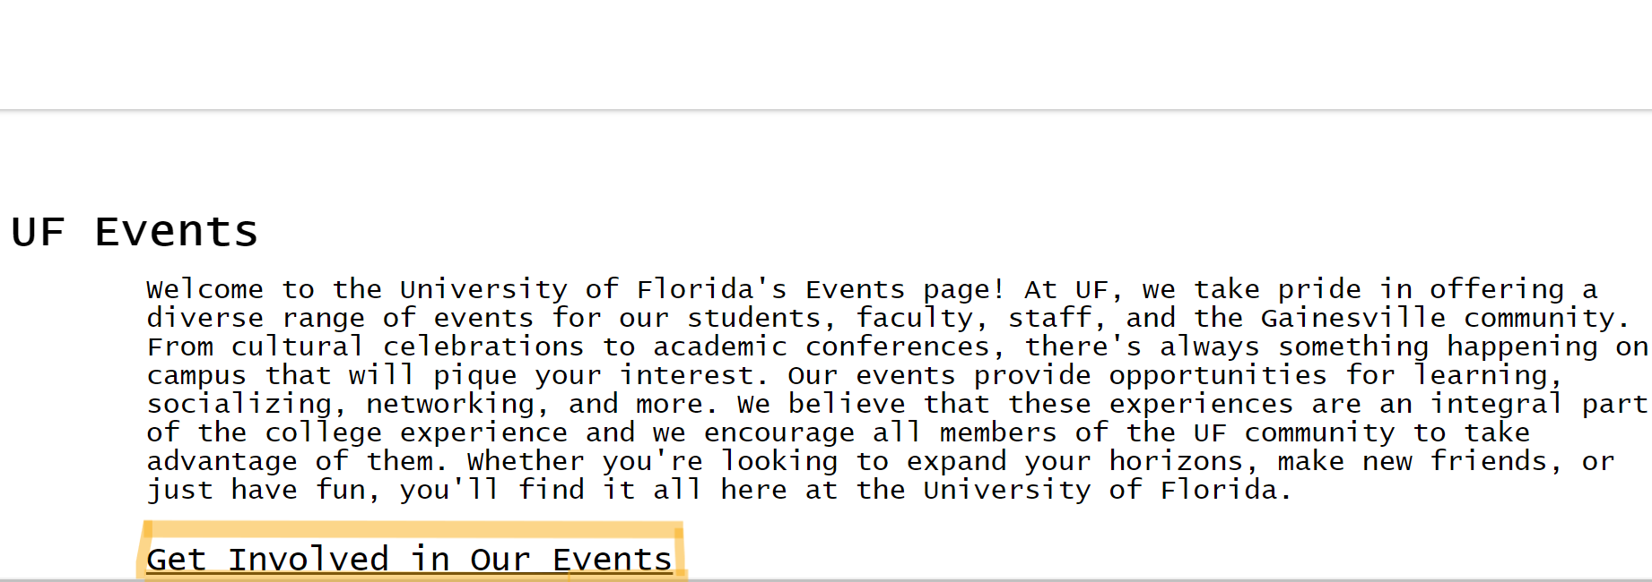
Initial Midterm Prototype

Slide 15
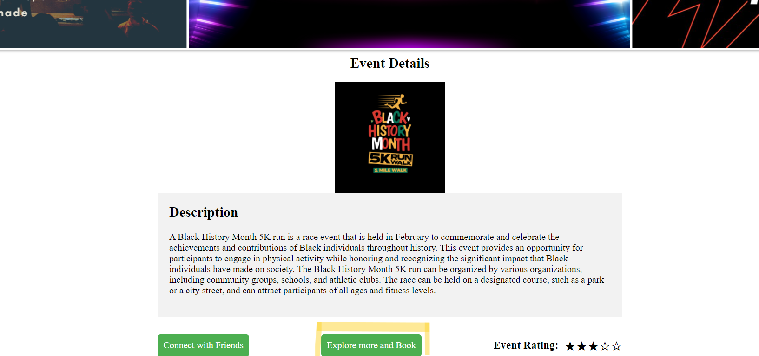
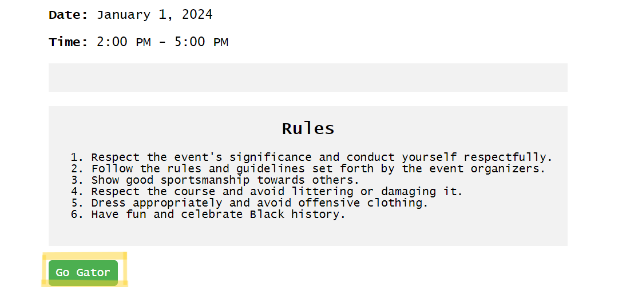
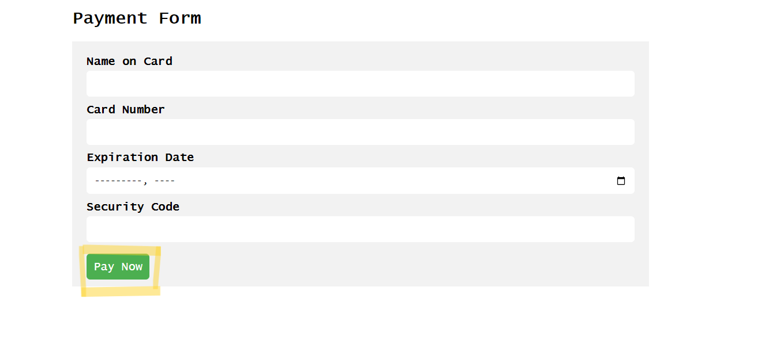
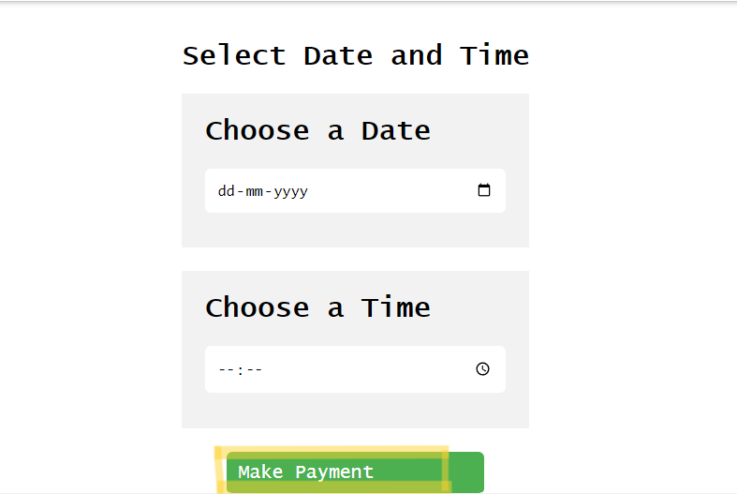
Initial Midterm Prototype

Slide 16
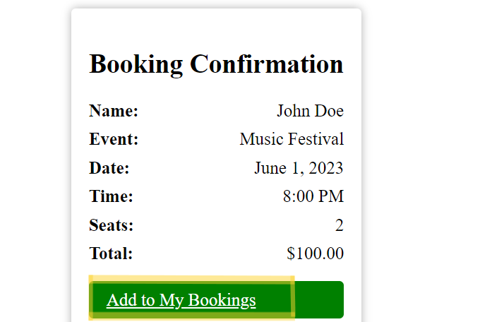
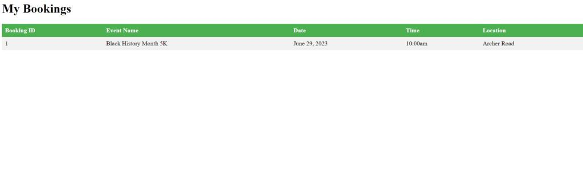
Initial midterm prototype

Slide 17
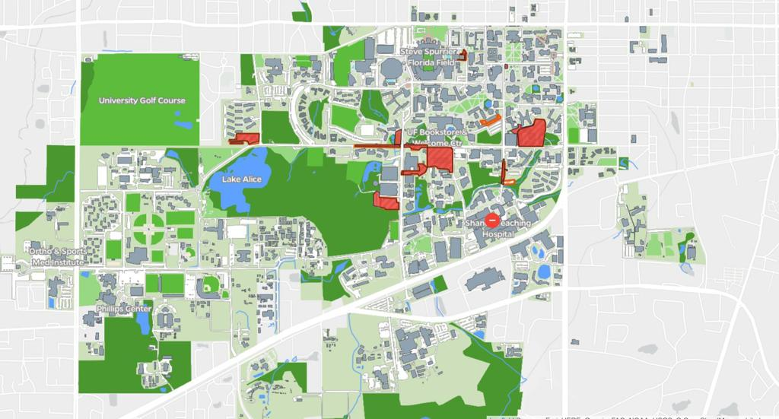
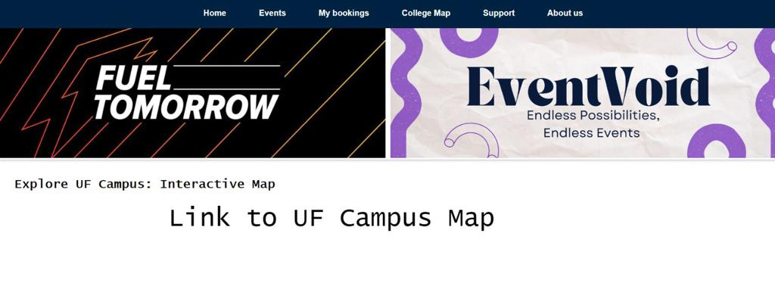
Initial Midterm Prototype
College map navigation button

Slide 18
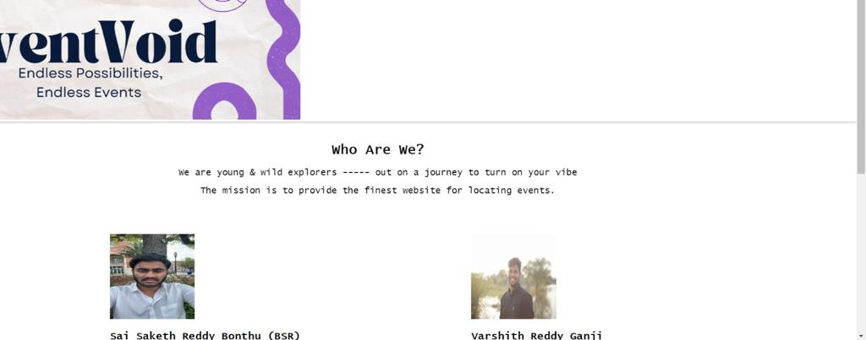
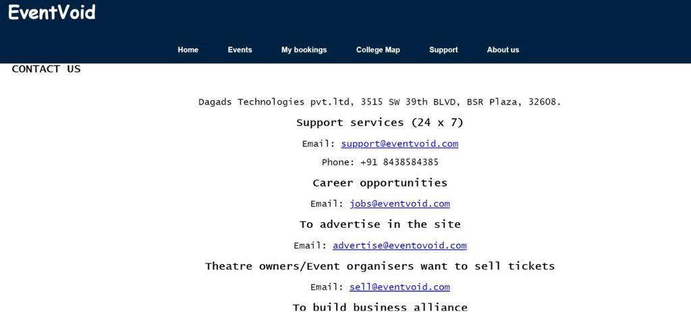
Initial Midterm Prototype
About Us navigation button
Support navigation button

Slide 19
ROADMAP
REQUIREMENTS GATHERING
01/09/2023
BRAINSTORMING
01/27/2023
FOCUS GROUP
02/03/2023
REQUIREMENTS GATHERED
02/03/2023
DIGITAL AFFINITY DIAGRAM
02/03/2023
PERSONAS
02/03/2023
SCENARIOS
02/03/2023
STORYBOARDS
02/03/2023
WIREFRAMING
02/09/2023
ENGINEERING (Creating final website using Django).
04/05/2023

